Slide 1
Mastering Opioid Withdrawal with COWS
Chandler Hicks
RN, MSN
Agustina Saenz
MD, MPH

Slide 2
Question 1: What percentage of patients on the 14th floor are on opioids on any given day?
a. 20 - 30%
b. 40 – 50%
c. 10 - 20%
d. 30 - 40%

Slide 3
Question 1: What percentage of patients on the 14th floor are on opioids on any given day?
a. 20 - 30%
b. 40 – 50%
c. 10 - 20%
d. 30 - 40%

Slide 4
Question 2: What percentage of patients that we order opioids for were opioid naïve before being admitted?
a. 25%
b. 15%
c. 35%
d. 5%

Slide 5
Question 2: What percentage of patients that we order opioids for were opioid naïve before being admitted?
a. 25%
b. 15%
c. 35%
d. 5%

Slide 6
Question 3: What percentage of those patients will become opioid-dependent one-year later?
a. 5%
b. 10%
c. 15%
d. 20%

Slide 7
Question 3: What percentage of those patients will become opioid-dependent one-year later?
a. 5%
b. 10%
c. 15%
d. 20%

Slide 8
Case 1
47-y/o F with h/o Crohn’s s/p colectomy and end colostomy.
On home OxyContin and oxycodone for chronic abdominal pain.
Presents w/ acute on chronic pain uncontrolled by home regimen.
She reports nausea/vomiting and increased ostomy output x3-4 days.
She always requests her 10mg dose of oxycodone and calls every 6 hours on the dot.
She consistently rates her pain 9/10.
The nurse notices that the patient frequently asks about her next dose and sets alarms on her phone
When the nurse is late with a dose, the patient becomes agitated.

Slide 9
Case 2
38M w/ h/o Psychoactive Substance Use Disorder (PSUD - heroin, cocaine, benzos).
Admitted for IV antibiotics after I&D of an antecubital abscess.
After the procedure, the patient is ordered for PRN IV Dilaudid q4h for pain and PRN Ativan q8h for anxiety.
On the floor, the patient appears agitated and demanding pain medicine. The nurse medicates the patient with Dilaudid and Ativan.
90 min later, the patient requests more pain medicine. Since he is not due for another 2.5 hours, he becomes verbally aggressive and threatens to leave AMA if he does not get an additional dose of Dilaudid.
The team orders for a x1 dose of IV Dilaudid but the patient falls asleep before receiving the dose.
Hours later, the patient is tachycardic to 115, hypertensive to 165/95, agitated and reporting 10/10 pain.
He is diaphoretic and that the box of tissues she brought in earlier is empty.

Slide 10
Case 3
21M w h/o SLE , APLS, with hx of PE (on Coumadin) admitted with MSSA bacteremia and generalized pain.
He was placed on a Dilaudid PCA and a few days later he was transferred to the ICU with MAS and multiorgan failure on steroids/anakinra.
In the ICU, he was intubated - the Dilaudid PCA was switched to a Fentanyl drip.
Pt slowly recovered and was transferred back to the floor.
The Fentanyl drip was replaced with Fentanyl 25 mcg q 2 h prn.
Patient’s mental status deteriorated again, was awake and following commands but non-verbal.
2 days after transfer, he was more tachycardic than usual, with HR up to 170s, sinus rhythm. His SBP was in the 180s. He was agitated, had a visible tremor, worse on his RUE. He was pointing towards his abdomen and head when asked about pain.
On exam, his pupils were dilated and was mildly diaphoretic. Abdomen was soft with no rebound or guarding.

Slide 11
Who to Monitor?
Buprenorphine induction
Pt on chronic opioids
Opioid abuse / addiction
Patients who received high doses on opioids on admission and are being tapered down (pts transferred from the ICU).

Slide 12
Flip Chart Activity:
Early and Late Symptoms

Slide 13
When to Monitor?
Opioid | Half Life | Onset of symptoms after exposure | Typical duration of withdrawal
Short Acting: Fentanyl | 11 - 36 hours (mean = 21 hours) | 3 – 5 hours | 4 - 5 days
Medium Acting: Heroin, Buprenorphine, Morphine, Oxycodone, Hydrocodone | Variable | 8 - 12 hours | 7 to 10 days (depending on the drug, secondary withdrawal can last as long as 6 months)
Long Acting: Methadone | 8 – 150 hours (mean = 35 hours) | 24 – 96 hours | 10 - 14 days (secondary withdrawal as long as 6 months)

Slide 14
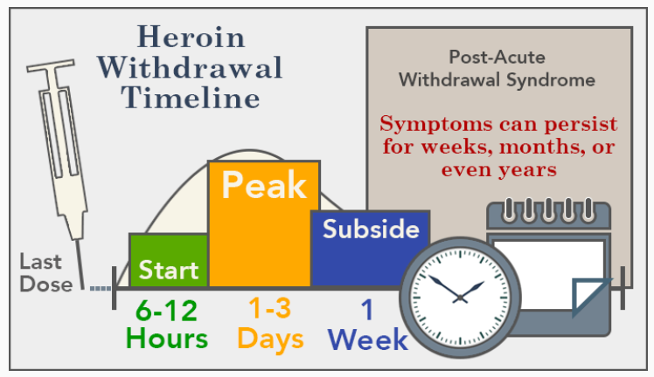
Heroin
Heroin Withdrawal TIMELINE

Slide 15
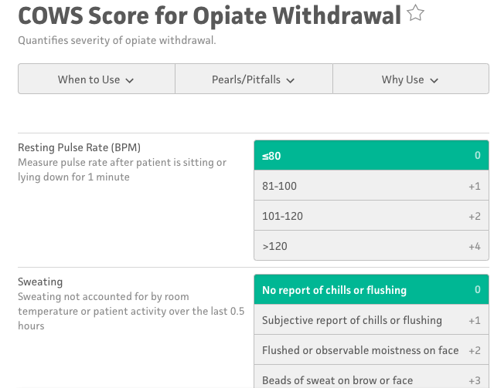
Heroin
COWS
Calculator
Click here for calculator

