Slide 1
Nurse-Doctor Co-Teaching Presents:
The Ins and Outs of HYPONATREMIA
Stephanie Simons, B.S., RN and Glen Kim, M.D., MPH

Slide 2
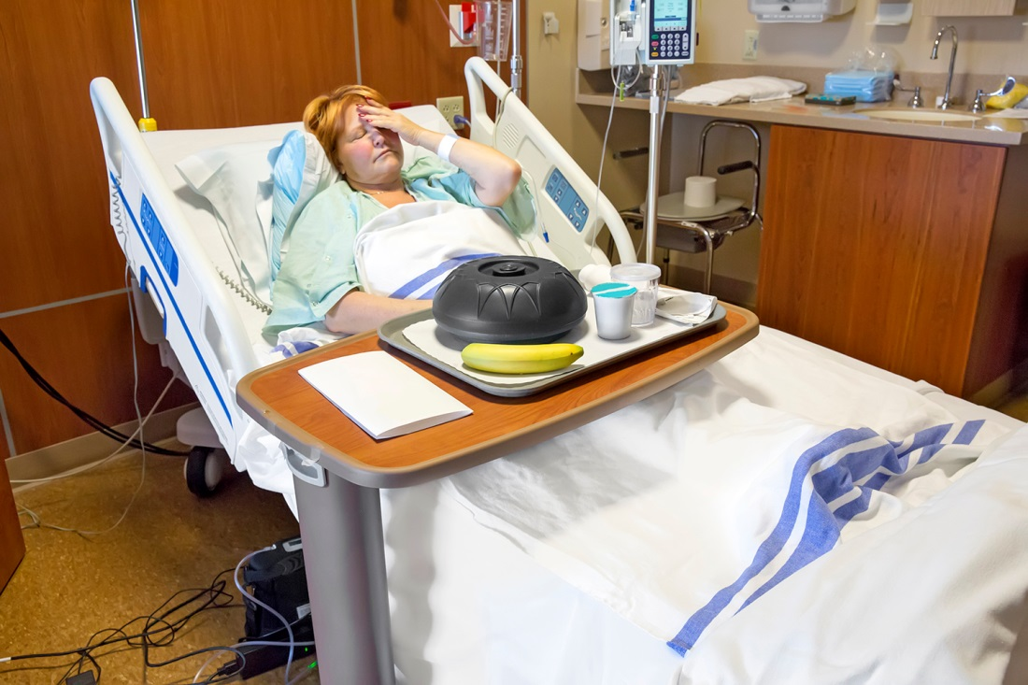
A 63 year-old woman is admitted overnight with abdominal pain, fatigue, and a sodium level of 121. You walk into her room in the morning and this is what you see.
What are 5 things that you notice (that are relevant to her low sodium)?

Slide 4

Interpreting this clinical vignette and photo in the context of her low sodium, what are 5 things that you notice?
Pain or stress, which could worsen hyponatremia
Plate covered, i.e. not eating, could contribute as well
Free water on the tray
IV connected, which could be a lot of things, beneficial or harmful
Banana, providing K, which is therapeutic for hyponatremia
Bedside commode , which might imply diarrheal volume losses in the setting of abdominal pain

Slide 5
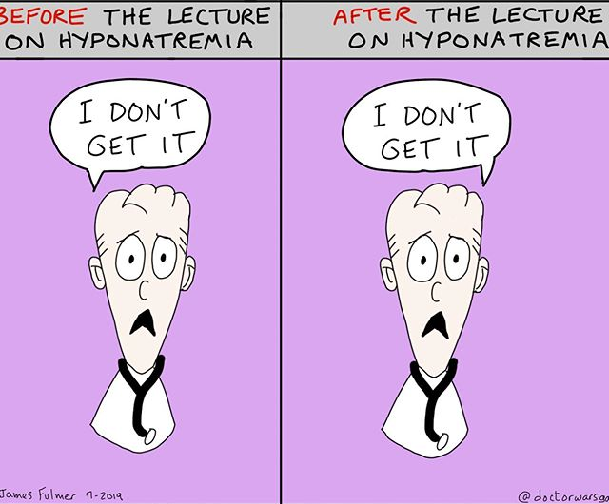
This Won't Occur Today!

Slide 6
Hyponatremia is complex!!!! Let’s try to simplify it
Learning objectives for this co-teaching session include:
Review why we care about the rate of correction of hyponatremia
Learn a framework for thinking about patients with hyponatremia
Recognize symptoms that stimulate anti-diuretic hormone (ADH)
Quantify oral intake in the hyponatremic patient
List overlooked sources of water intake

Slide 7
Cerebral Edema
If you do not correct Hyponatremia

Slide 8
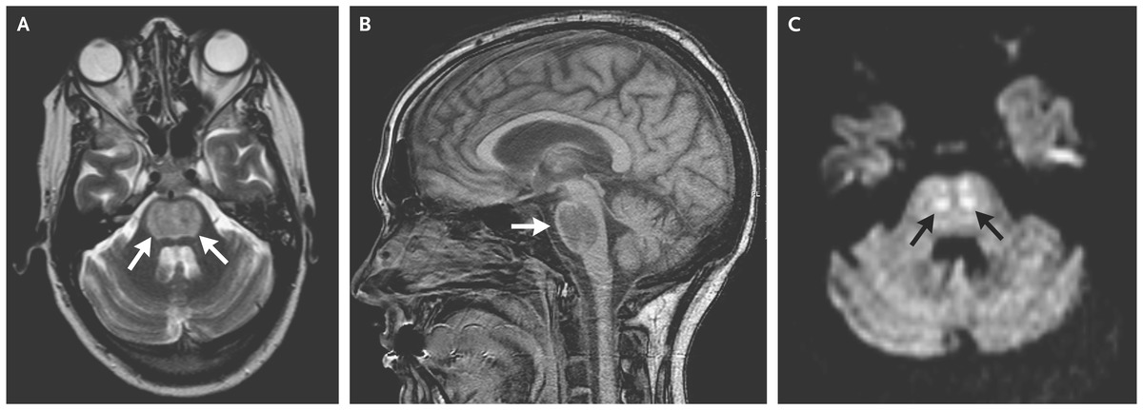
What is a safe rate of sodium correction?
Feared complication = Osmotic Demyelination Syndrome (formerly called Central Pontine Myelinolysis)
Maximum = 8 mEQ in a 24-hour period for severe, chronic hyponatremia
Mild hyponatremia = 130-134 mEQ
Moderate hyponatremia = 120-129mEQ
Severe hyponatremia = <120mEQ
N Engl J Med 2016; 374:e8 DOI:10.1056/NEJMicm1504134

Slide 9
What studies should we order to determine etiology?
Serum:
Basic metabolic panel
Serum Osmolality
TSH
Am cortisol
Depending on the Na level, recheck BMP every 4-12 hours
Urine:
Urine Na
Urine Osmolality
Best if urine sample obtained at the same time as basic metabolic panel!!

Slide 10
Step-Wise Approach to Hyponatremia – Dr. Glen Kim

Slide 11
How much Water can one drink?
 | Young and Healthy | Elderly | ETOH | Lung Tumor
PO Solute | 600-900 | 300 | 400 | 600
Urine Osm | 50 | 150 | 100 | 600
(Animate) | 18 L | 2L | 4L | 1L
Dx | Psychogenic | Tea and Toast | Beer Potomania | SIADH

Slide 12
Putting it All Together!
Three Physiology Factoids | Three Key Questions | Diagnosis
1) ADH @ distal nephron retains water | 1) Something bad is likely stimulating ADH. What is it? | Could be anything! And not just ADH-secreting tumors. Any physiologic stressor can stimulate ADH
2) You can’t urinate only free water. Nephrons need solute to dump water (e.g. Salt tabs are given not to raise the Na, but to help dump water) | 2) Is the patient eating? | Think about reasons for low PO intake: Is it elderly, starvation, substance abuse, depression, food insecurity?
3) Urine Osm relates #1 and #2 and tells us the water limit… | 3) is patient getting extra fluids at bedside? | IV drips, IV meds, pink pitcher

Slide 13
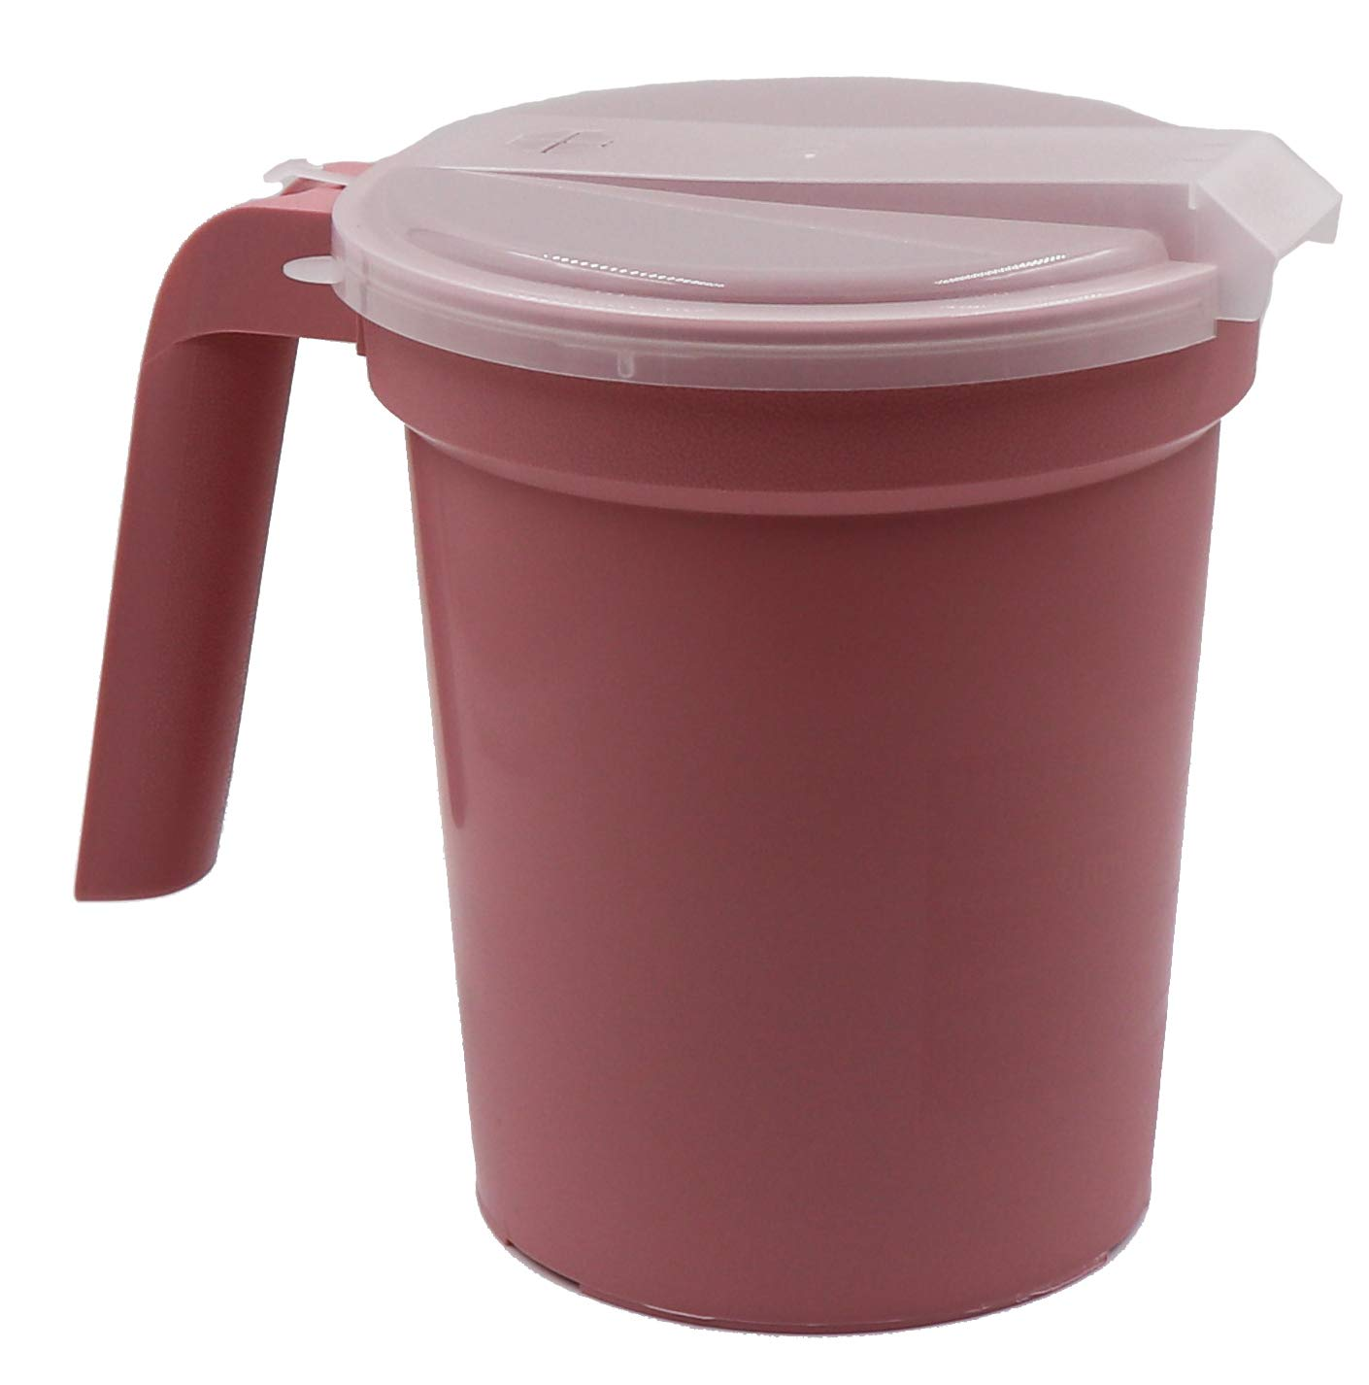
How do we measure strict Intake and Output?
What are the steps we need to take?
Put sign on the door
Talk to patient care assistant (PCA)
Talk to patient!
  How do we teach the patient?
Ice chips count as fluid!
How do we track the intake?
Various methods depending on the patient
Remember that IV medications also count towards the total intake

Slide 14
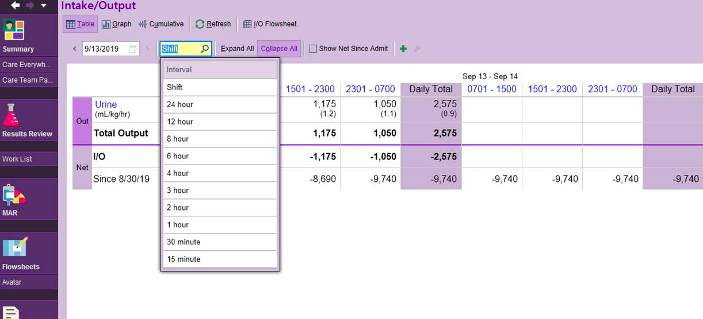
Nurse and Doctor I/Os charting in EPIC

Slide 15
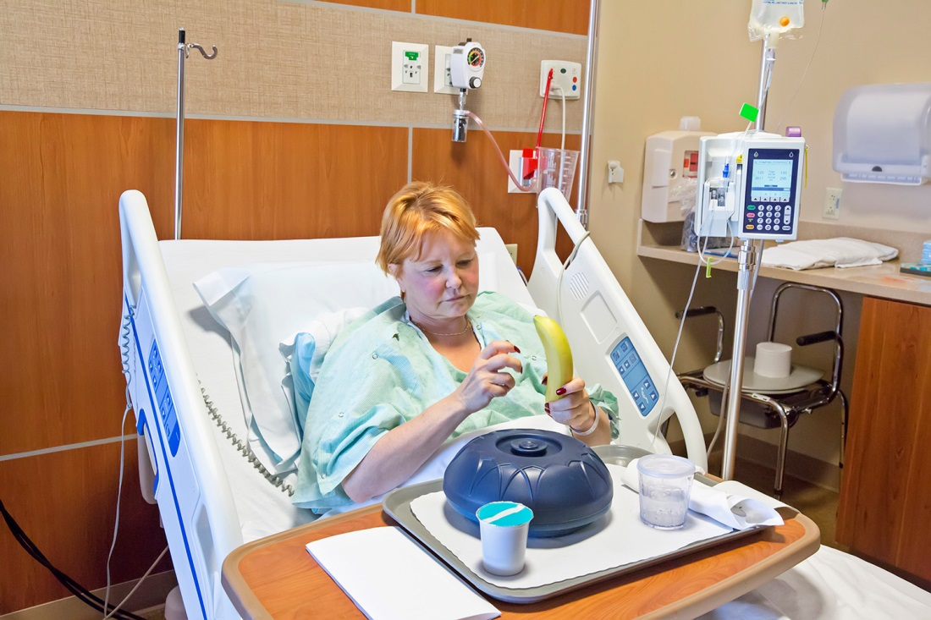
THANK YOU!!!!

