Slide 1

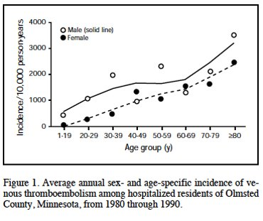
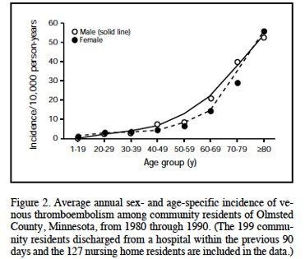
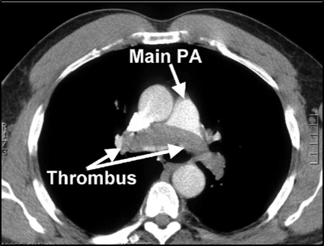
Venous Thromboembolism on GMS:
Can We Make a Difference?
Brenda Bailey, R.N., Ralph Blair, M.D.
RISK STRATIFICATION
team work
High Risk​ | Major Orthopedic Surgery​ Major Surgery for cancer​ Craniotomy or spinal surgery​ Bariatric surgery​ Polytrauma​ Critical illness in ICU​ 2+ Moderate Risk Factors (below)​
appreciation
PATIENT EDUCATION
UPON DISCHARGE
Risks of VTE
VTE prevention
Signs and symptoms of VTE
Who and when to call if VTE suspected
Markedly Increased (100 Times) VTE Risk for Hospitalized Patients Compared to Community Residents (Heit JA Mayo Clin Proc 2001; 76: 1102)
listening
collegiality
SIGNIFICANT BENEFIT
to VTE PROPHYLAXIS
interprofessional
Alternatives/Adjuncts to Pharmacological Therapy
mutual respect
Saddle Embolus
Early and frequent ambulation​
Inadequate and not always feasible​
Mechanical Compression​
Main mechanism “milking” effect evacuates leg vein​
Reduces venous stasis​
Possible effect on fibrinolysis but that remains unproven​
Hydration - low volume state can lead to hemoconcentration and low venous flow​
Monitor UO​
Provide fluids either PO or IV​
ALTERNATIVE METHODS
for VTE PROPHYLAXIS
Educate
Ambulate
Hydrate
Mechanical compression
understanding
patient care
communication
learning together
collaboration
Produced by Emily Piper-Vallillo, M.Ed., Marina Zambrotta, M.D., and Helen Shields, M.D.

