Slide 1
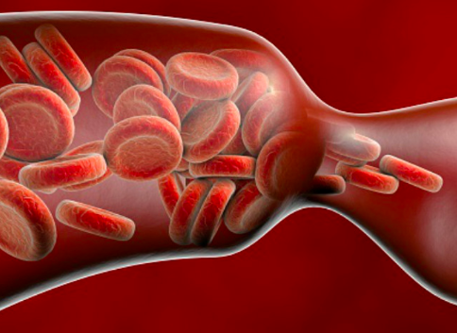
Venous Thromboembolism on GMS:
Can we make a difference?
Brenda Bailey, RN
and Ralph Blair, MD

Slide 2

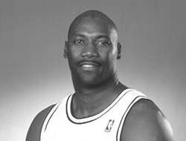

JEROME KERSEY
A Video
Notes:
Speaker: Ralph
Start the video at 45 seconds and let play for only about 15 seconds.

Slide 3
CLINICAL
VIGNETTE 1
A 52-year old retired National
Basketball Association (NBA)
Forward in good health underwent uncomplicated knee surgery. ​
A few days later, he left his work at
the Portland Trail Blazers office, feeling
poorly. ​
Later that day, first responders were summoned to his home and took him to a local hospital where he died. ​
At post-mortem, he was found to have a fatal pulmonary embolism.
Notes:
Speaker: Ralph

Slide 4
CLINICAL
VIGNETTE 2
A previously healthy 48-year-old
woman named Barbara s/p routine laparoscopic cholecystectomy one week prior
suddenly collapses at home while cooking breakfast for her family.
When the Emergency Medical
Response Team arrives, she is found to be in Pulseless Electrical Activity (PEA) cardiac arrest.
Despite heroic resuscitation efforts, she passes away.
Notes:
Speaker: Ralph

Slide 5
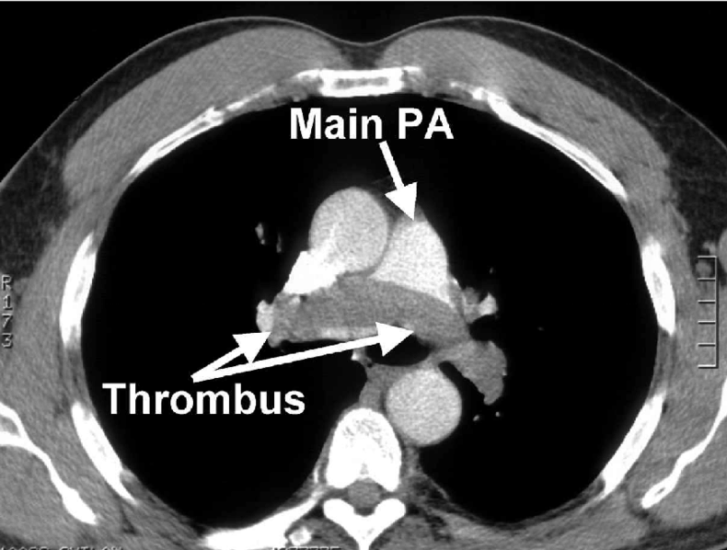
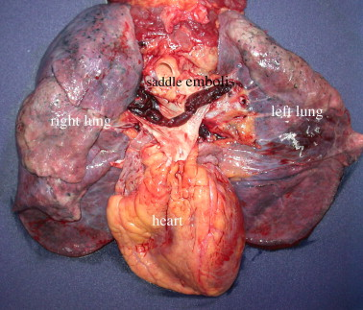
What Do They Both Have in Common?
Notes:
Speaker: Ralph

Slide 6
LEARNING OBJECTIVES
1. Describe the significant incidence of venous thromboembolism (VTE) in hospitalized patients
2. List risk stratification procedures for VTE in the hospitalized patient
3. Review the efficacy of pharmacological VTE prophylaxis
4. Recognize that patient education about VTE should occur prior to hospital discharge.
Notes:
Speaker: Ralph 1 and 3, Brenda 2 and 4.
Check with Brenda about revising Learning Objective #4 to more adequately suggest all that she is teaching (she is also teaching about WHAT patients should learn before being discharged).

Slide 7
Time for …
a VTE Fact Quiz!
Record your answers on the scratch card.
If you find a star, you have the correct answer.
Keep scratching until you find a star.
Discuss your thoughts with a neighbor.
Notes:
Speaker: Ralph

Slide 8
Question 1
Compared to people in the community, the age and sex adjusted incidence of DVT and PE in hospitalized patients is:
  A. 50 times higher
  B. 100 times higher
  C. 200 times higher
  D. 250 times higher
Notes:
Speaker: Ralph

Slide 9
Which of the following is considered high risk for VTE according to BWH risk stratification order set?
A. Bariatric surgery
B. Prior history of VTE
C. Laparoscopic cholecystectomy
D. Pneumonia
Question 2
Notes:
Speaker: Brenda

Slide 10
Compared to patients receiving no prophylaxis, the risk ratio for pulmonary embolism (PE) in recipients of unfractionated heparin (UFH) or low molecular weight heparin (LMWH) is:
Remember! Lower ratio = greater risk reduction
  A. 0.7-0.9
  B. 0.6-0.8
  C. 0.4-0.6
  D. 0.1-0.3
Question 3
Notes:
Speaker: Ralph

Slide 11
Compared to Unfractionated Heparin, the risk ratio for Pulmonary Embolus in hospitalized recipients of Low Molecular Weight Heparin is:
  A. 0.9
  B. 0.75
  C. 0.3
  D. 0.6
Question 4
Notes:
Speaker: Brenda

Slide 12

Let's Review the Correct Answers!
Notes:
Speaker: Ralph

Slide 13
Question 1
Compared to people in the community, the age and sex adjusted incidence of DVT and PE in hospitalized patients is:
  A. 50 times higher
  B. 100 times higher
  C. 200 times higher
  D. 250 times higher
Notes:
Speaker: Ralph

Slide 14
Question 1
Compared to people in the community, the age and sex adjusted incidence of DVT and PE in hospitalized patients is:
  A. 50 times higher
  B. 100 times higher
  C. 200 times higher
  D. 250 times higher
Notes:
Speaker: Ralph

Slide 15
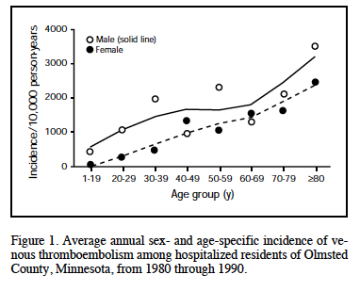
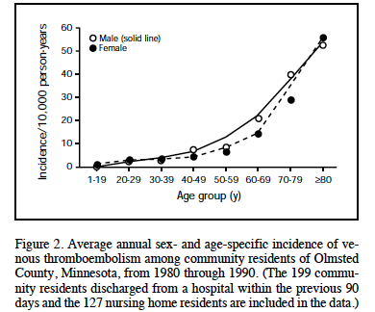
Markedly Increased (100 Times) VTE Risk for Hospitalized Patients Compared to Community Residents (Heit JA Mayo Clin Proc 2001; 76: 1102)
Hospitalized Residents
Non-Hospitalized Residents
Notes:
Speaker: Ralph

Slide 16
Which of the following is considered high risk for VTE according to BWH risk stratification order set?
A. Bariatric surgery
B. Prior history of VTE
C. Laparoscopic cholecystectomy
D. Pneumonia
Question 2
Notes:
Speaker: Ralph

Slide 17
Which of the following is considered high risk for VTE according to BWH risk stratification order set?
A. Bariatric surgery
B. Prior history of VTE
C. Laparoscopic cholecystectomy
D. Pneumonia
Question 2
Notes:
Speaker: Ralph

Slide 18
Prophylaxis Risk Stratification
High Risk | Major Orthopedic Surgery Major Surgery for cancer Craniotomy or spinal surgery Bariatric surgery Polytrauma Critical illness in ICU 2+ Moderate Risk Factors (below)
Moderate Risk | Major Surgery (duration greater than 45 minutes) not including major orthopedic, cancer, or spine surgery (see above) Acute illness or immobility with greater than 48 hours anticipated LOS PMHx of VTE or known thrombophilia (including hormone therapy) Active malignancy or receiving treatment for cancer (excluding short stay for chemo infusion)
Low Risk | Ambulating patients staying less than 48 hours not meeting criteria for moderate/high risk
RISK
MATTERS
Notes:
Speaker: Ralph

Slide 19
How to decide on VTE prophylaxis
The BWH/Epic protocol is based on specialty society guidelines
1. Determine Clotting Risk:
High Risk: Prior Clot, Active Cancer, Inflammatory Bowel Disease, Age >60, Heart Failure, COPD, Immobile >3days
2. Determine Bleeding Risk:
High Risk: Active Peptic Ulcer Disease, Recent GI Bleed (within 3 months), platelets < 50,000
3. Other Considerations:
  Patients not at high-bleeding risk should receive chemical prophylaxis.
  High-bleeding risk patients should receive mechanical prophylaxis.
Notes:
Speaker: Ralph

Slide 20
Compared to patients receiving no prophylaxis, the risk ratio for pulmonary embolism (PE) in recipients of unfractionated heparin (UFH) or low molecular weight heparin (LMWH) is:
Remember! Lower ratio = greater risk reduction
  A. 0.7-0.9
  B. 0.6-0.8
  C. 0.4-0.6
  D. 0.1-0.3
Question 3
Notes:
Speaker: Ralph

Slide 21
Compared to patients receiving no prophylaxis, the risk ratio for pulmonary embolism (PE) in recipients of unfractionated heparin (UFH) or low molecular weight heparin (LMWH) is:
Remember! Lower ratio = greater risk reduction
  A. 0.7-0.9
  B. 0.6-0.8
  C. 0.4-0.6
  D. 0.1-0.3
Question 3
Notes:
Speaker: Ralph

Slide 22
How effective is Pharmacological Prophylaxis for Thromboembolism in Hospitalized Patients?
Meta-Analysis of 36 studies for Pharmacological Prophylaxis of In–Hospital patients
Two Methods showed significant reduction in:
Unfractionated Heparin: RR 0.64 for Pulmonary Embolus
Most effective dose was 5000 units three times a day.
Low Molecular Weight Heparin: RR 0.37 for Pulmonary Embolus
Direct Comparison: Low molecular weight heparin versus unfractionated heparin was associated with a lower rate of DVT: RR 0.68
No difference in mortality was noted for either agent despite fewer Pulmonary Emboli
(Wein L, et al. Arch Intern Med 2007;167:1471486.)
Notes:
Speaker: Ralph

Slide 23
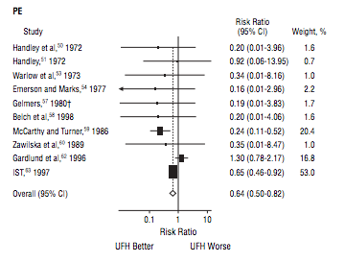
How effective is UFH prophylaxis?
Notes:
Speaker: Ralph

Slide 24
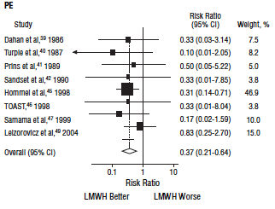
How effective is LMWH prophylaxis?
Notes:
Speaker: Ralph

Slide 25
Compared to Unfractionated Heparin, the risk ratio for Pulmonary Embolus in hospitalized recipients of Low Molecular Weight Heparin is:
  A. 0.90
  B. 0.75
  C. 0.3
  D. 0.6
Question 4
Notes:
Speaker: Ralph
Revise this question to make clearer.

Slide 26
Compared to Unfractionated Heparin, the risk ratio for Pulmonary Embolus in hospitalized recipients of Low Molecular Weight Heparin is:
  A. 0.90
  B. 0.75
  C. 0.3
  D. 0.6
Question 4
Notes:
Speaker: Ralph

Slide 27
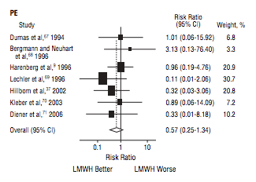
LMWH vs. UFH
Notes:
Speaker: Ralph

Slide 28
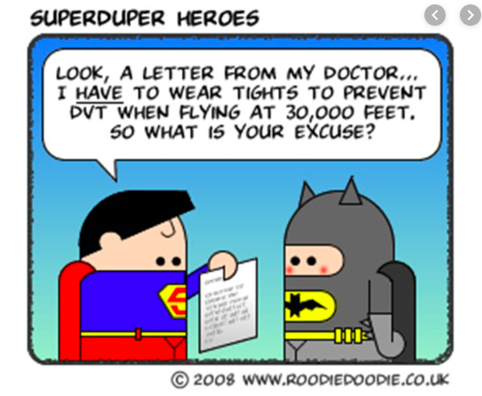
Notes:
Speaker: Brenda

Slide 29
Alternatives/Adjuncts to Pharmacological Therapy
Early and frequent ambulation
Not always feasible
Mechanical Compression
Main mechanism “milking” effect evacuates leg vein
Reduces venous stasis
Possible effect on fibrinolysis but that remains unproven
Hydration - low volume state can lead to hemoconcentration and low venous flow
Provide fluids either PO or IV
+++ Lippi, Giuseppe & Favaloro, Emmanuel & Cervelli, Gianfranco. (2011). Prevention of Venous Thromboembolism: Focus on Mechanical Prophylaxis. Seminars in thrombosis and hemostasis. 37. 237-51. 10.1055/s-0031-1273088.
+++ Aesthetic Surgery Journal, 2015, Vol 35(7) 839–841 Keiter, J., Johns, D., and Rockwell, W. DOI: 10.1093/asj/sjv070 www.aestheticsurgeryjournal.com
Notes:
Speaker: Brenda

Slide 30
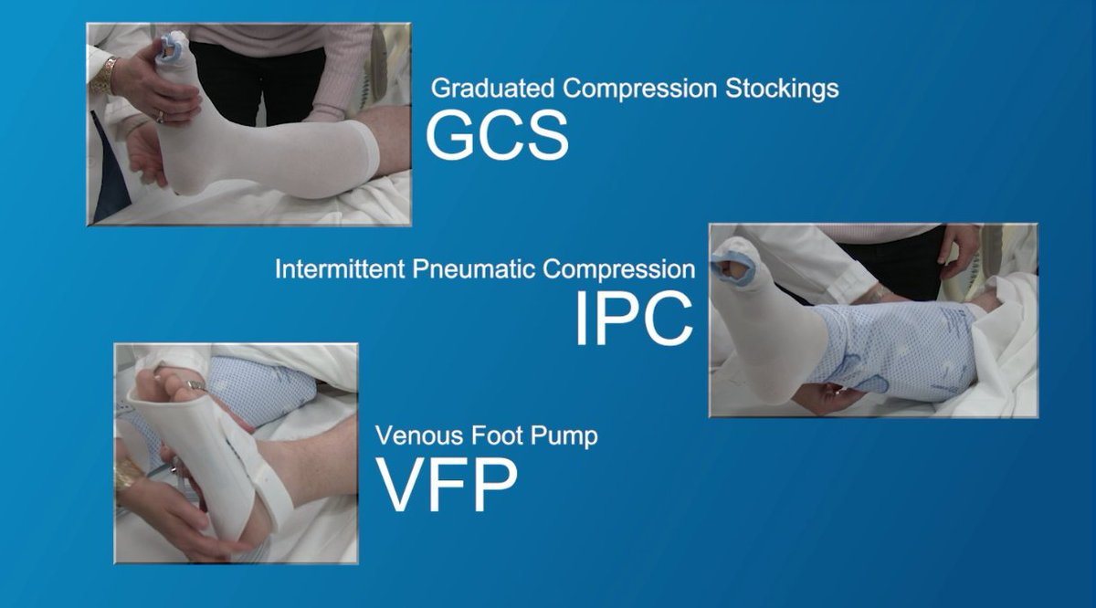
Mechanical DVT Prophylaxis
Practical considerations:
1. Pneumatic Boots- can’t get out of bed easily
2. Efficacy data for prevention of clots is marginal
Notes:
Speaker: Brenda

Slide 31
You have a patient who is high risk for DVT by the BWH Risk Stratification Order Set and they are adamantly refusing prophylactic LMWH injections.
What would you do? Turn to your neighbor and discuss.
Notes:
Speaker: Brenda

Slide 32
Medicine Quality Improvement Initiative on 14AB, 14CD, 10BA
Nurse Education Program
Script provided for most frequent reason for refusals.
Handout from CDC provided to patient
Documentation standardized for patient refusal.
Weekly refusal rates sent to VTE champions
Follow up e-mails sent to RN’s
The Result:
Refusal Rates have dropped below hospital goal of 10%​
Notes:
Speaker: Brenda

Slide 33
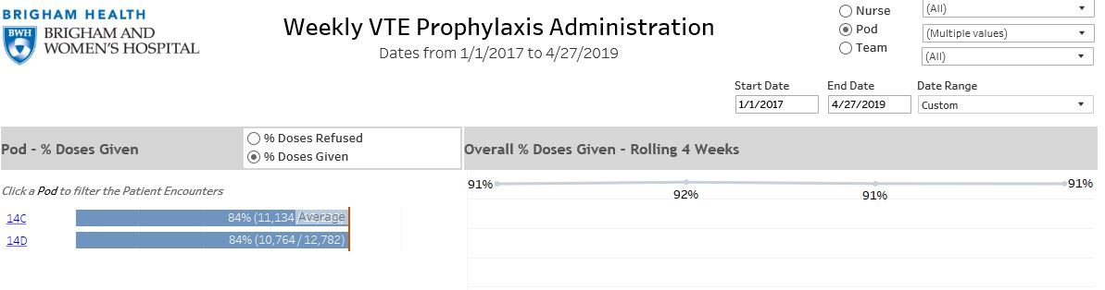
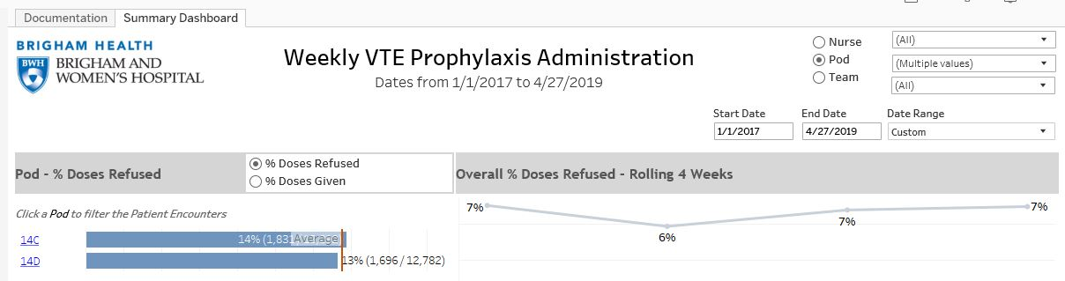
Notes:
Speaker: Brenda

Slide 34
What could we have done to save Barbara?
Pulmonary Embolism/Deep Vein Thrombosis Following Laparoscopic Cholecystectomy:
Nationwide Inpatient sample showed VTE prevalence after laparoscopic cholecystectomy was low and Pulmonary Embolus is rare – 4,107,430 LAPCHOL performed 1998 – 2009.
In hospital prevalence of Pulmonary Embolus 0.15%, DVT 0.40%
Deaths related to in hospital Pulmonary Embolus was 0.02% (no existing National Surveillance System monitoring post hospitalization VTE/PE )
(Clinical and Applied Thrombosis/Hemostasis Stein, P., Matta, F., and Sabra, M. 2014, Vol. 20(3) 233-237)
Notes:
Speaker: Brenda

Slide 35

Design a
Discharge
Education Sheet for
VTE Prevention
Working with your neighbor, design a discharge sheet to educate all patients about how to prevent VTE.
Think about how you can translate this information to a patient, as opposed to a medical professional.
Feel free to use visuals!
Candy is available for everyone who completes a design!
Notes:
Speaker: Brenda

Slide 36
Patient Discharge Education Sheet:
Design the optimal educational sheet for all patients, feel free to include visuals
Notes:
Speaker: Brenda

Slide 37
Improved awareness can improve patient outcomes
Risks of VTE
Consequences of VTE
VTE Prevention
Signs and Symptoms of VTE
Importance of seeking medical intervention if VTE is suspected
Who to contact if VTE is suspected
Patient Discharge Education Should Include:​
Notes:
Speaker: Brenda

Slide 38
New horizons in DVT and PE prevention
Role for DOACs in Discharged Patients
MAGELLAN trial:
  Rivaroxaban 35 days versus Enoxaparin 10 days in acute medical patients
  Direct Oral Anticoagulant (DOAC) non-inferior for 10 days, better at 35 days (RR 0.77)
  However, more bleeding: RR 2.3 at 10 days, RR 2.5 at 35 days
  (NEJM 368:513, 2013)
MARINER Trial:​
  Rivaroxaban 10 mg x 45 days after acute medical hospitalization versus placebo​
  Study stopped for futility. Event rate in placebo group only 1.1% versus anticipated 2.5%​
  (NEJM 379:1118, 2018)
Notes:
Speaker: Ralph

Slide 39

FDA Approves
Rivaroxaban at
Discharge for 39 Days based on Magellan Trial
October 15, 2019
FDA approved rivaroxaban (Xarelto) for the prevention of venous thromboembolism (VTE) in hospitalized, acutely ill patients at risk who do not have a high bleeding risk.
This is a new indication where acutely ill patients would be prescribed the direct oral anticoagulant in the hospital and for 31- 39 days post-hospitalization.
Notes:
Speaker: Ralph
Helen Added.

Slide 40

Together, let's embark on the fantastic voyage to prevent VTE
Notes:
Speaker: Ralph

Slide 41
