Slide 1

THE AGONY AND ECSTASY OF TELEMETRY ALARMS
Stephanie Bartelt, BSN and Bram Wispelwey, MD, MS, MPH

Slide 2
Chat with your Neighbor
Tell your neighbor one indication for telemetry monitoring that you have noticed at the Brigham.
Time: 1 minute

Slide 3
Share with Group
What is one indication for telemetry monitoring that you have noticed at the Brigham?
Time: 1 minute

Slide 4
Learning Objectives
1. List the current guidelines for telemetry monitoring
2. Explain the mechanics of standard telemetry lead placement and how it differs from routine EKG lead placement
3. Recognize the distinction between Low, Moderate and High-Risk Groups for Telemetry Monitoring.

Slide 5
CASES
Directions:
For the following cases, consider whether you think the patient should be placed on telemetry.
If you think Yes, Stand Up.
If you think No, Stay Seated.
Time: 1 minute
Notes:
Presenters ask the following questions: 1. Should this patient be monitored on telemetry? 2. In your experience are they usually put on telemetry for this?
Ask participants to turn to their neighbor and chat for 30 seconds.

Slide 6
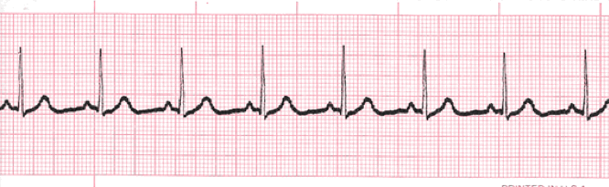
Case 1
Telemetry, Yes or No?
68-year old female with hx COPD on 2L oxygen coming in with cough, tachycardia to 110 bpm, blood pressure of 130/80, stable oxygen requirement, being treated for community acquired pneumonia.
Time: 1 minute
Notes:
Presenters ask the following questions: 1. Should this patient be monitored on telemetry? 2. In your experience are they usually put on telemetry for this?
Ask participants to turn to their neighbor and chat for 30 seconds.

Slide 7
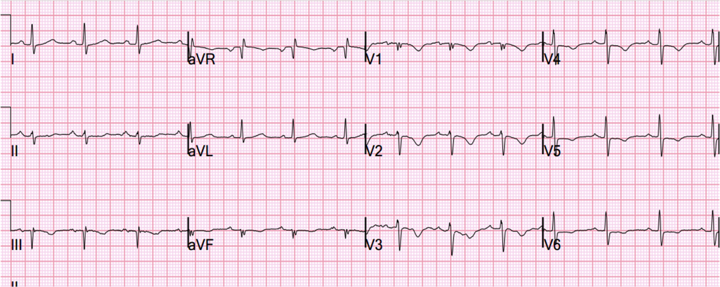
Case 2
Telemetry, Yes or No?
A 56-year old male with history of hypertension, hyperlipidemia, obesity, 30-pack year smoking history, presents with chest pain. His Hs-troponin level 3 hours apart 10 --> 60.
Time: 1 minute
Notes:
Presenters ask the following questions: 1. Should this patient be monitored on telemetry? 2. In your experience are they usually put on telemetry for this?
Ask participants to turn to their neighbor and chat for 30 seconds.

Slide 8
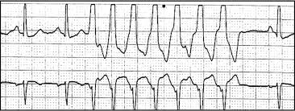
Case 3
Telemetry, Yes or No?
A 45-year old male presents with watery diarrhea 4 days after returning from a Caribbean cruise and is found to have norovirus. Labs are notable for a K of 2.3 mmol/L and Magnesium of 1.5 mg/dl. In the ER, this rhythm is noted on the tracing below.
Time: 1 minute
Notes:
Presenters ask the following questions: 1. Should this patient be monitored on telemetry? 2. In your experience are they usually put on telemetry for this? 3. What if the K is 4.1?
Ask participants to turn to their neighbor and chat for 30 seconds.

Slide 9
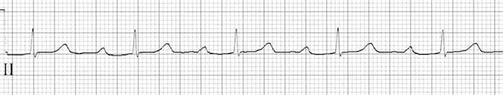
Case 4
Telemetry, Yes or No?
A 25-year-old male with a history of IVDU admitted with fevers, fatigue and found to have S. aureus bacteremia. Given concern for infective endocarditis, an EKG is performed.
Time: 1 minute
Notes:
Presenters ask the following questions: 1. Should this patient be monitored on telemetry? 2. In your experience are they usually put on telemetry for this?
Ask participants to turn to their neighbor and chat for 30 seconds.

Slide 10
Current Relevant AHA Telemetry Guidelines
Telemetry Indicated | Telemetry NOT Indicated
New Onset or Recurrent Atrial Tachycardias | Chronic Afib
Any Atrial Arrythmia with Hemodynamic Instability | NSVT
Syncope (if cardiac etiology suspected) | Asymptomatic Sinus Bradycardia
Endocarditis | 2nd Degree Heart Block, Mobitz 1 (I.e. Wenckebach)
Acute Decompensated Heart Failure | PPM or ICD (if unrelated to admission)
Moderate to Severe K or Mag Imbalance (Severe hypoK < 2.5, severe hypoMag < 1.3) | Post NON-Cardiac Surgery (if asymptomatic)
Stroke | Chronic Hemodialysis
Drug Overdose
Post-Conscious Sedation (until awake and alert)

Slide 11
Now that we know the guidelines, let's review the cases....

Slide 12
Case 1
NO!
Telemetry, Yes or No?
68-year old female with hx COPD on 2L oxygen coming in with cough, tachycardia to 110 bpm, blood pressure of 130/80, stable oxygen requirement, being treated for community acquired pneumonia.
Time: 1 minute
Notes:
Presenters ask the following questions: 1. Should this patient be monitored on telemetry? 2. In your experience are they usually put on telemetry for this?
Ask participants to turn to their neighbor and chat for 30 seconds.

Slide 13
Case 2
YES!
Telemetry, Yes or No?
A 56-year old male with history of hypertension, hyperlipidemia, obesity, 30-pack year smoking history, presents with chest pain. His Hs-troponin level 3 hours apart 10 --> 60.
Time: 1 minute
Notes:
Presenters ask the following questions: 1. Should this patient be monitored on telemetry? 2. In your experience are they usually put on telemetry for this?
Ask participants to turn to their neighbor and chat for 30 seconds.

Slide 14
Case 3
YES!
Telemetry, Yes or No?
A 45-year old male presents with watery diarrhea 4 days after returning from a Caribbean cruise and is found to have norovirus. Labs are notable for a K of 2.3 mEq/dl and Magnesium of 1.5 mg/dl. In the ER, this rhythm is noted on the tracing below.
Moderate Hypokalemia 2.5-2.9
Severe Hypokalemia < 2.5
Severe Hypomagnesemia < 1.3
Notes:
Presenters ask the following questions: 1. Should this patient be monitored on telemetry? 2. In your experience are they usually put on telemetry for this? 3. What if the K is 4.1?
Ask participants to turn to their neighbor and chat for 30 seconds.

Slide 15
Case 4
YES!
Telemetry, Yes or No?
A 25-year-old male with a history of IVDU admitted with fevers, fatigue and found to have S. aureus bacteremia. Given concern for infective endocarditis, an EKG is performed.
Time: 1 minute
Notes:
Presenters ask the following questions: 1. Should this patient be monitored on telemetry? 2. In your experience are they usually put on telemetry for this?
Ask participants to turn to their neighbor and chat for 30 seconds.

Slide 16
But what about low risk vs high risk telemetry?

Slide 17
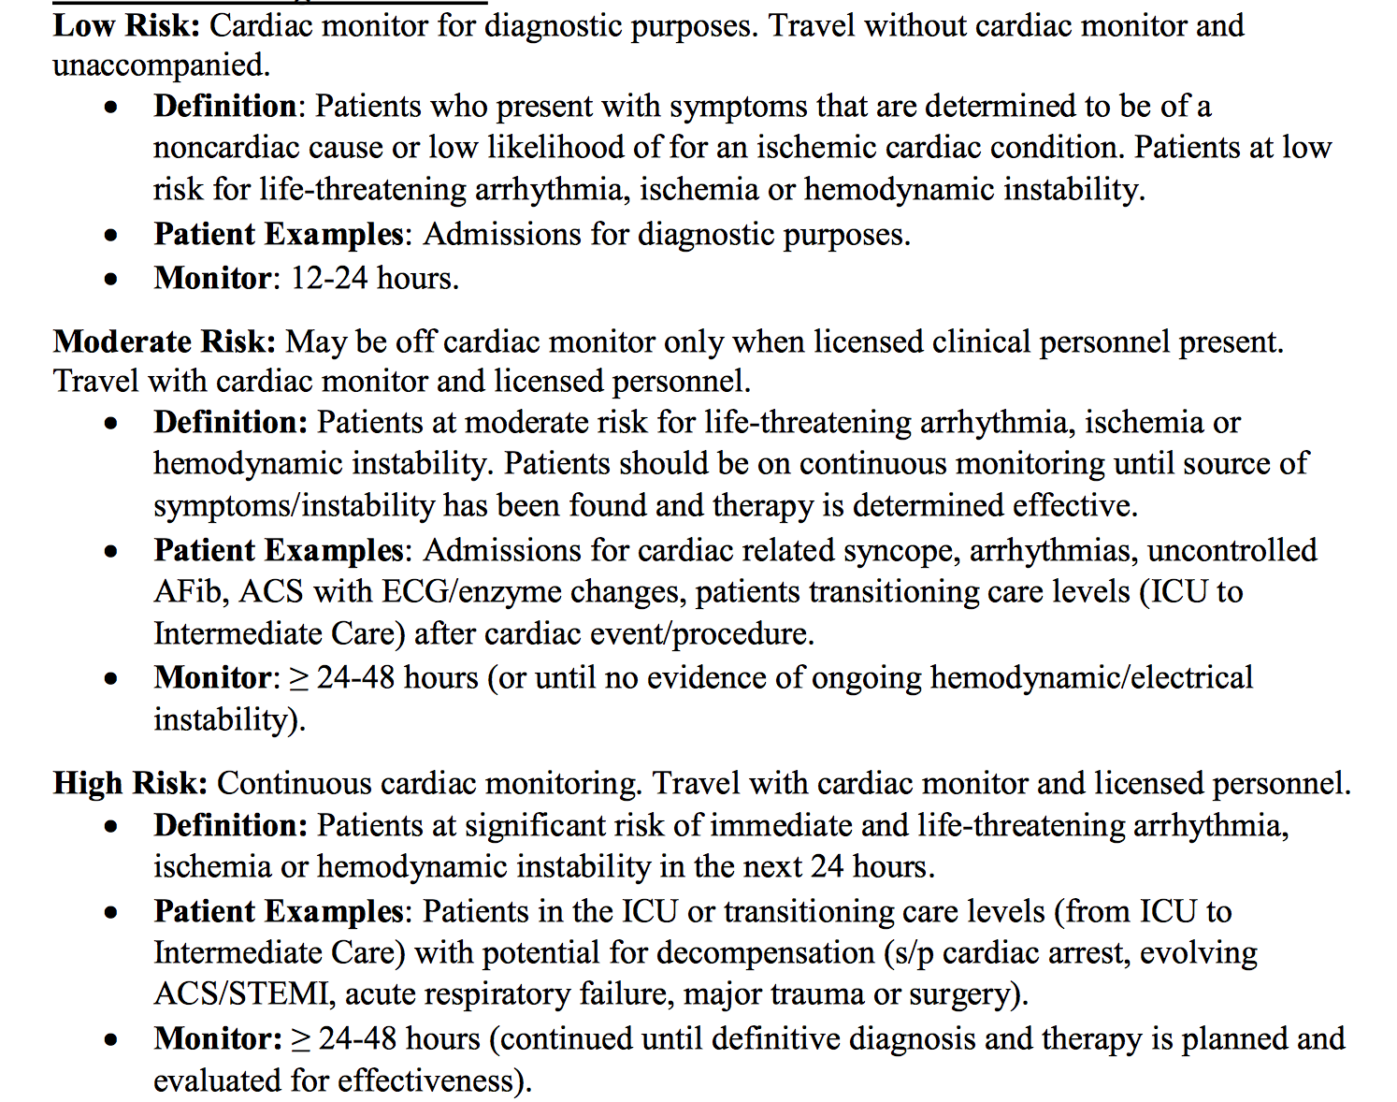
Recognize BWH Indications for Low, Moderate, and High Risk Telemetry
LOW
MODERATE
HIGH

Slide 18
Now that we've made a decision to order telemetry for our patient and have risk stratified them for monitoring,
how do we put the leads on?

Slide 19
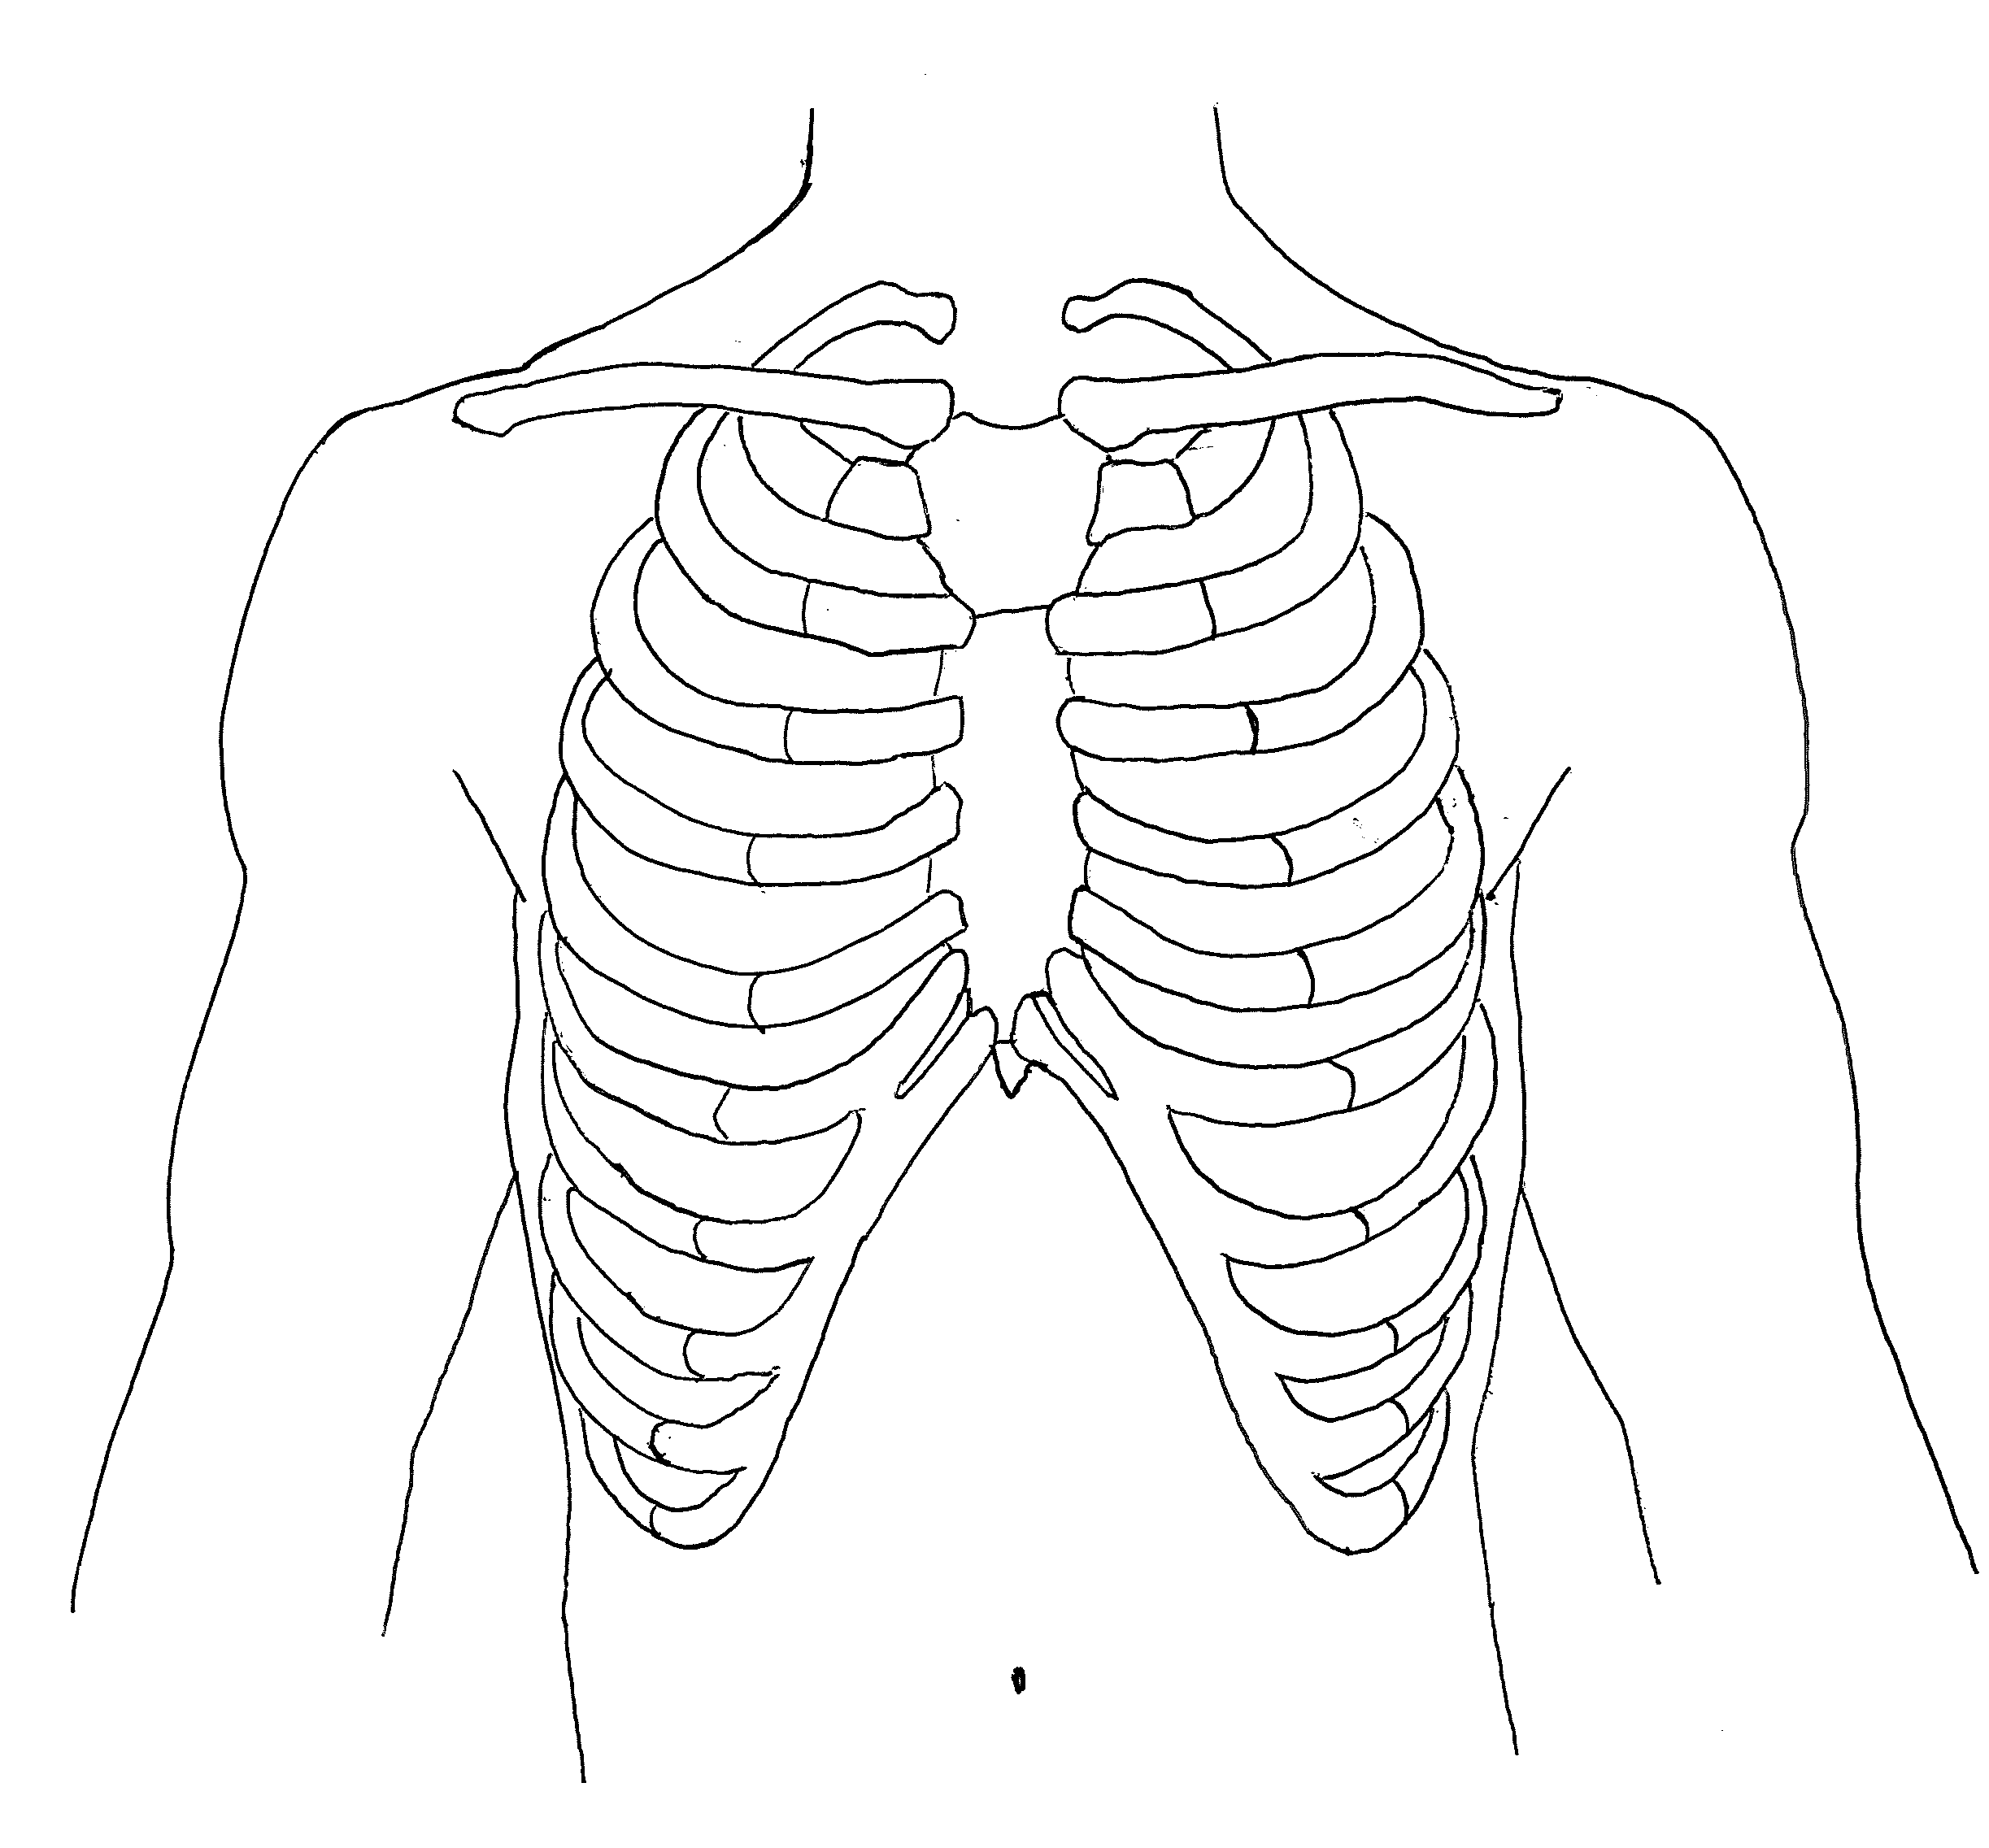
Mechanics of Telemetry Lead Placement
Directions: Working with your neighbor, place each jellybean in the correct spot for telemetry lead placement.
Time: 3 minutes
Notes:
Presenters can explain that all the people who get the correct telemetry lead placement get a surprise!

Slide 20
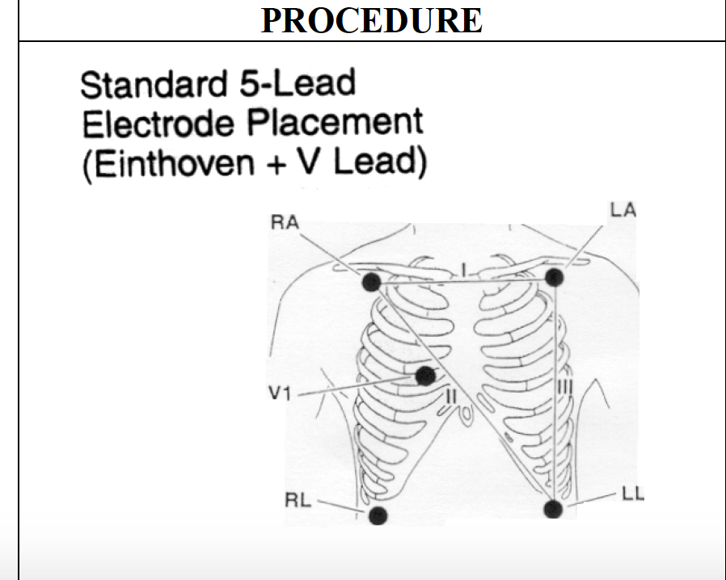
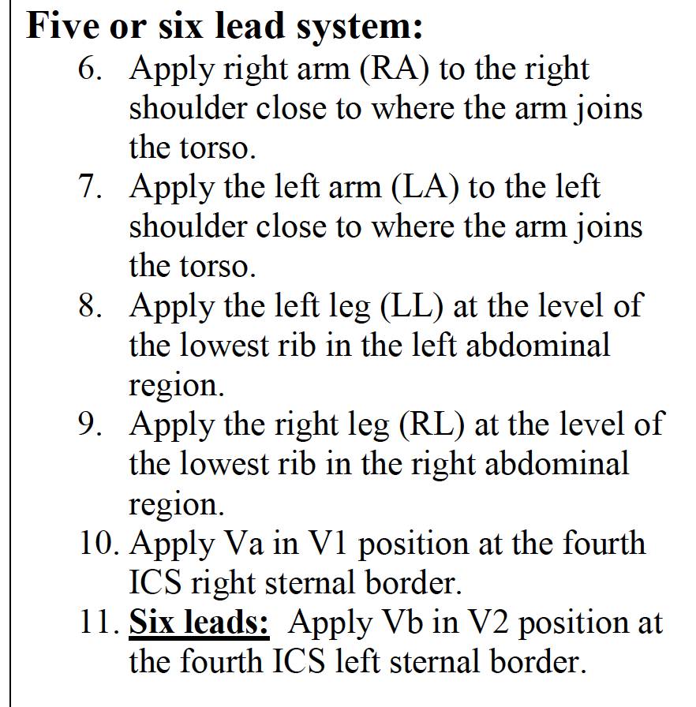
Correct Telemetry Lead Placement

Slide 21
Current Relevant AHA Telemetry Guidelines
Telemetry Indicated | Telemetry NOT Indicated
New Onset or Recurrent Atrial Tachycardias | Chronic Afib
Any Atrial Arrythmia with Hemodynamic Instability | NSVT
Syncope (if cardiac etiology suspected) | Asymptomatic Sinus Bradycardia
Endocarditis | 2nd Degree Heart Block, Mobitz 1 (I.e. Wenckebach)
Acute Decompensated Heart Failure | PPM or ICD (if unrelated to admission)
Moderate to Severe K or Mag Imbalance (Severe hypoK < 2.5, severe hypoMag< 1.3) | Post NON-Cardiac Surgery (if asymptomatic)
Stroke | Chronic Hemodialysis
Drug Overdose
Post-Conscious Sedation (until awake and alert)
Time: 2 minutes

