Slide 1

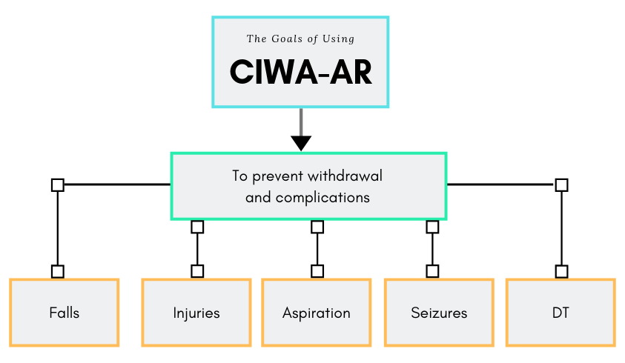
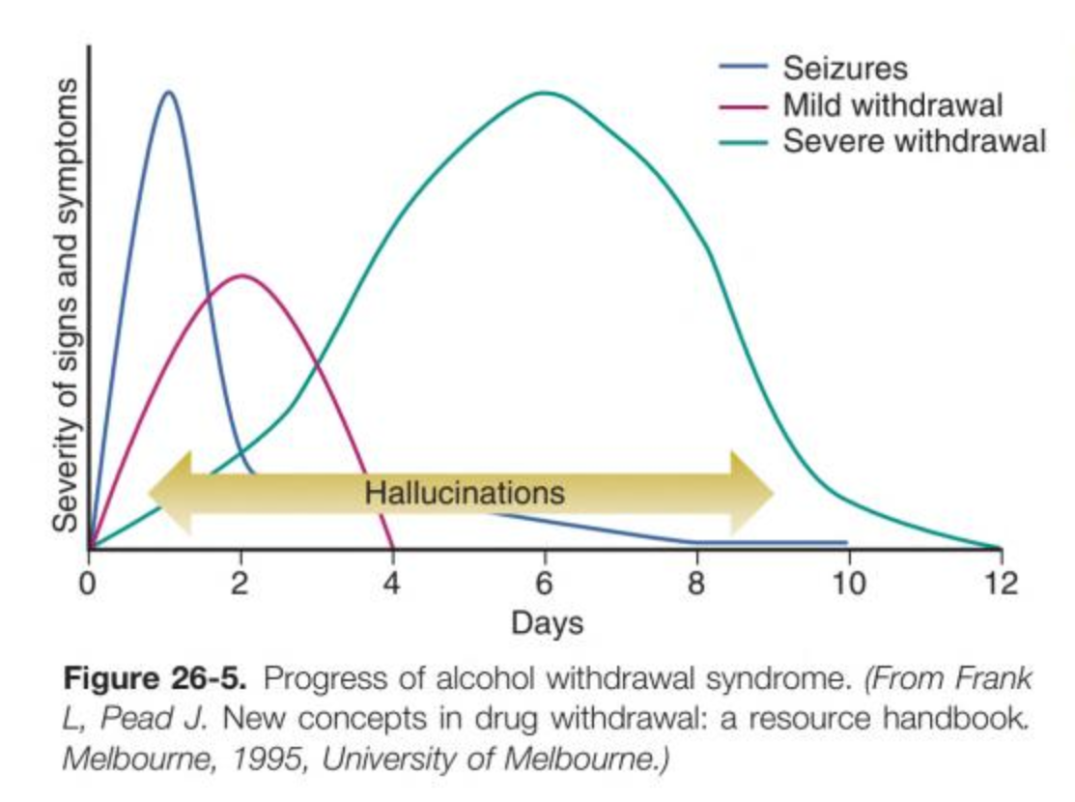
BWH CIWA-Ar Best Practices
Holli Murray and Bill Martin-Doyle
CIWA-Ar stands for Clinical Institute Withdrawal Assessment for Alcohol scale
team work
The CIWA-Ar is a subjective scale that is used for symptom-triggered therapy and must be interpreted carefully.
appreciation
Symptoms of Withdrawal include:
6 – 12 Hours
Anxiety
Diaphoresis
Headache
Nausea/vomiting
Tremor
12 – 24 Hours
Hallucinations
24 – 48 Hours
Seizures
48 – 72 Hours
Agitation
Disorientation
Delirium tremens
Hypertension
Tachypnea
Tachycardia
listening
Both CIWA-based and Fixed-dose protocols require constant reassessment and collaboration between the RN and Clinician.
collegiality
Contraindications for CIWA protocol include delirium, inability to communicate, and severe alcohol withdrawal.
interprofessional
mutual respect
Timeline of Alcohol Withdrawal
Note: Seizures occur in the first 24 – 48 hours after cessation of drinking.
understanding
patient care
Stern TA, et al. Massachusetts General Hospital - Comprehensive Clinical Psychiatry, Second Edition. Elsevier 2016
communication
learning together
collaboration
Produced by Emily Piper-Vallillo, M.Ed., Marina Zambrotta, M.D., and Helen Shields, M.D.

